Slide 1
CSCI 2200: Intro to Unix bash Scripting

Slide 2
CSCI 2200: Intro to Unix printf

Slide 3
printf
We usually use echo for output to stdout
quick and easy
If we need some formatting, though, we can use printf
no newline (add \n)
formatting flags (some):
%s string %d, %i signed decimal integer %o unsigned octal integer %x, %X hexadecimal integer %f floating point number %% literal ‘%’

Slide 4
printf
jack@csci2200:~$ printf "hello world\n"
hello world
jack@csci2200:~$ a="hello"; b="world"
jack@csci2200:~$ printf "%s %s\n" "$a" "$b"
hello world
jack@csci2200:~$ printf "%10s %s\n" "$a" "$b"
hello world
jack@csci2200:~$ printf "%-10s %s\n" "$a" "$b"
hello world
jack@csci2200:~$
A couple of ways to use printf
The second & third example show how we can pad the output

Slide 5
CSCI 2200: Intro to Unix Stream I/O

Slide 6
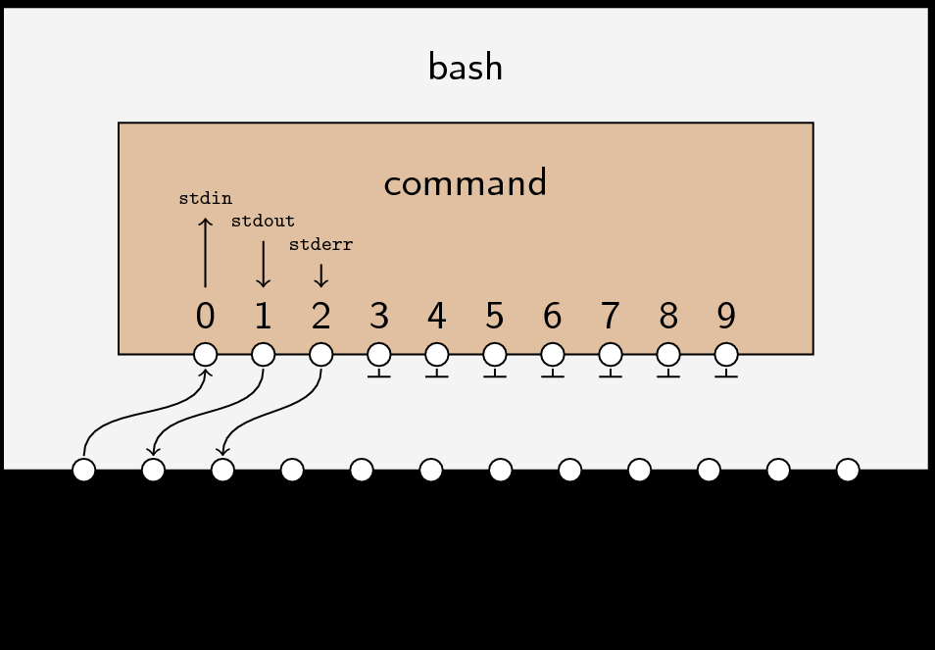
Stream I/O

Slide 7
Opening Files
bash, by default, associates
file descriptors 0, 1, and 2 with /dev/tty (initially, open)
file descriptors 3 .. 9 with no files (initially, closed)
To associate bash file descriptor fd with file.txt and open file.txt for access, use
exec fd< file.txt for read-only access
exec fd> file.txt for write-only access
exec fd>> file.txt for append-only access
exec fd<> file.txt for read-write access
exec returns 0 when opens succeed, nonzero on open failure: e.g., file not found (for reading), inadequate permissions

Slide 8
One-Line Reads
read options name₁ name₂ …. name_{n}
read next line from current input stream (default: stdin),
using $IFS as a word delimiter (default is \n)
assigning
word 1 to name₁ ,
word 2 to name₂ , and so forth,
with any remaining characters assigned to name_{n}
returning 0 on successful read, nonzero on read failure: e.g., end-of-file

Slide 9
One-Line Reads
read options name₁ name₂ …. name_{n}
Selected options:
-r - disable interpretation of backslash on input as special character
http://wiki.bash-hackers.org/commands/builtin/read: always use -r
-n n – read up to n characters or EOL, whichever comes first
-N n – read exactly n characters
-p prompt – prompt as part of read
-s – silent mode; don't echo characters
-t n – timeout; return failure if read not completed in n seconds
-u fd – read from file descriptor fd (default: 0)

Slide 10
Line-at-a-Time Reads: Example
jack@csci2200:~$ ls -o /etc | tail -n +2 | grep -E -v "^(d|l)" |\ > for ((i=0; i<5; i++)); do
> read -r permissions links owner size mmon mday myear name
> echo "$permissions $owner $size $name"
> done
-rw-r--r--. root 45 adjtime
-rw-r--r--. root 1512 aliases
-rw-r--r--. root 12288 aliases.db
-rw-------. root 541 anacrontab
-rw-r--r--. root 391 ant.conf
jack@csci2200:~$
Showing read to parse and filter output from ls -o
tail -n +2 discards initial "totals" line
grep -E -v "^(d|l)" discards listings for directories, symbolic links

Slide 11
Whole-Stream Reads
readarray options array infile
read infile into array, one line per array item
options (selected)
-n n - read at most n lines (default: read entire file)
-O n - drop first n lines from file before reading
-t - drop trailing newlines
potential use: out-of-order processing of input file's lines

Slide 12
Whole-Stream Reads : Example
jack@csci2200:~$ readarray -n 3 -t data </etc/passwd
jack@csci2200:~$ IFS=:
jack@csci2200:~$ for ((i=2; i>=0; i--)); do
> read -r account password uid gid username homedir shell <<<"${data[$i]}"
> echo "$username: $account $homedir"
> done
daemon: daemon /sbin
bin: bin /bin
root: root /root
jack@csci2200:~$
Showing readarray with read to process content from /etc/passwd
readarray -n 3 -t data reads the first three lines of /etc/password into an array named data, dropping final newlines
The for loop reads data 's contents in reverse order,
using read to parse each line, with : ($IFS) as field separator
discarding the uid, gid, password, and shell fields
reordering the username, account, and homedir fields for the output

Slide 13
Writes
command m>&n
redirect command's output for stream m (default: 1, stdout) to file descriptor n

Slide 14
Closing Files
To disassociate bash file descriptor fd from file.txt and close file.txt, use
exec fd<&- file.txt to end read access
exec fd>&- file.txt to end write access

Slide 15
Stream I/O with Auxiliary fd's: Examples
jack@csci2200:~$ echo $'a\nb\nc' >file1; echo $'0\n1\n2\n3\n4' >file2
jack@csci2200:~$ exec 3< file1; exec 4< file2
jack@csci2200:~$ while true; do
> read -u 3 -r w1; s1=$?
> read -u 4 -r w2; s2=$?
> if [ "$s1" -gt 0 ] && [ "$s2" -gt 0 ]; then break; fi
> echo $w1 $w2
> done
a 0
b 1
c 2
3
jack@csci2200:~$ exec 3<&-; exec 4<&-
jack@csci2200:~$ rm -rf file1 file2
jack@csci2200:~$
Using bash to do a two-way paste
If the two status codes are non-zero, both reads have failed

Slide 16
Stream I/O with Auxiliary fd's: Examples
jack@csci2200:~$ echo $'a\nb\nc' >file1; echo $'0\n1\n2\n3' >file2
jack@csci2200:~$ exec 3< file1; exec 4< file2; exec 5> result
jack@csci2200:~$ while true; do
> read -u 3 -r w1; s1=$?
> read -u 4 -r w2; s2=$?
> if [ "$s1" -gt 0 ] && [ "$s2" -gt 0 ]; then break; fi
> echo $w1 $w2 >&5
> done
jack@csci2200:~$ exec 5>&-
jack@csci2200:~$ cat result
a 0
b 1
c 2
3
jack@csci2200:~$ exec 3<&-; exec 4<&-
jack@csci2200:~$ rm -rf file1 file2 result
jack@csci2200:~$
Like the previous example, but writing the output to a file, result

Slide 17
CSCI 2200: Intro to Unix exit

Slide 18
exit : Examples
jack@csci2200:~$ bash
jack@csci2200:~$ echo this statement executes; exit
this statement executes
jack@csci2200:~$ echo $?
0
jack@csci2200:~$ bash
jack@csci2200:~$ exit 4; echo this statement never executes
jack@csci2200:~$ echo $?
4
jack@csci2200:~$
The exit command halts the current bash session, returning a final status of
0 if supplied with no arguments
the specified value otherwise

Slide 19
exit : Examples
jack@csci2200:~$ bash
jack@csci2200:~$ a=1; b=2; c=3
jack@csci2200:~$ exit "$a$b$c"
jack@csci2200:~$ echo $?
123
jack@csci2200:~$ bash
jack@csci2200:~$ exit zzz
exit: zzz: numeric argument required
jack@csci2200:~$ echo $?
255
jack@csci2200:~$
exit, unlike most bash constructs, converts strings to numeric values
If supplied with an argument that can't be parsed as a number, exit writes a message to stderr and returns 255

Slide 20
CSCI 2200: Intro to Unix basic format

Slide 21
Scripts: Basic Format (review)
bash scripts are text files that
start, by convention, with the single line #!/bin/bash
consist of a combination of
Unix commands and/or
bash built-ins
have execute permission
a bash script can be run by
entering its name at a prompt, preceded by
a path to the file: e.g., ./foo for a script named foo in the current directory

Slide 22
Scripts: Parameters
bash scripts can accept parameters
Their mechanisms for accepting and using parameters are identical to those for functions: i.e.,
$0 denotes the name used to invoke the script
$# references the number of parameters
$1 .. $9 reference the first nine parameters
shift is needed to access parameters beyond the 9th
arrays can't be passed as themselves, but must be passed as a sequence of values, using syntax like ${a[@]}

Slide 23
Script Parameters: $0, $#, shift
jack@csci2200:~$ cat test
#!/bin/bash
echo called as "$0"; echo -n called with "$#" parameter
case "$#" in
0) echo s;;
1) echo ": $1";;
*) echo -n "s: "; while (($# > 1)); do echo -n $1', '; shift; done; echo $1;;
esac
jack@csci2200:~$ chmod u+x test
jack@csci2200:~$ ./test
called as test
called with 0 parameters
jack@csci2200:~$ ./test 1
called as test
called with 1 parameter: 1
jack@csci2200:~$ ./test 1 2 3
called as test
called with 3 parameters: 1, 2, 3
jack@csci2200:~$

Slide 24
Managing Problem Parameters
If parameters can contain whitespace, double-quote them
if [ -e $1 ]; then sleep 0; fi
will fail when $1 is 'a b'
if [ -e "$1" ]; then sleep 0; fi
will succeed when $1 is 'a b'
If parameters can be missing when nounset is disabled, double-quote them
if [ -z $1 ]; then sleep 0; fi
will fail when $1 is undefined
if [ -z "$1" ]; then sleep 0; fi
will succeed when $1 is undefined

Slide 25
Varying Script Behavior by Name
jack@csci2200:~$ cat test
#!/bin/bash
if [ "$0" = "./etad" ]; then date else echo try again fi
jack@csci2200:~$ chmod u+x test; ln test etad
jack@csci2200:~$ ./test
try again
jack@csci2200:~$ ./etad
Tue Feb 9 13:46:57 EST 2016
jack@csci2200:~$

Slide 26
CSCI 2200: Intro to Unix trap

Slide 27
trap
The trap built-in, particular to scripting, is a signal-catcher
trap allows scripts to detect and manage signals, apart from the uncatchables: i.e., SIGKILL, SIGSTOP, SIGCONT
trap is particularly important for scripts that create temp files
It can be used to clean up any temporary files a script might have created before exiting

Slide 28
trap: Syntax
trap -l - list system-supported signals and their corresponding numbers
trap -p sig_list - list commands associated with items in sig_list
trap cmd sig_list - execute cmd when any event in sig_list is triggered
Contents of sig_list:
any signal except SIGKILL, SIGSTOP, and SIGCONT
ERR – catches computations that return 0 and nonzero status returns from commands, except for
commands in a command list immediately after a while or until keyword
commands that are part of a test in an if statement
commands that are in an && or ││ list
commands whose return values are being inverted via !

Slide 29
trap : Examples
jack@csci2200:~$ cat test
#!/bin/bash
#
i=0
trap 'let i=i+1; echo $(date): \
catch "#"$i'
SIGINT SIGQUIT
#
while true; do
sleep 1
echo looping
done
jack@csci2200:~$
jack@csci2200:~$ ./test
looping
looping
^CTue Feb 23 12:47:19 EST 2016: catch #1
looping
^\Quit (core dumped)
Tue Feb 23 12:47:20 EST 2016: catch #2
looping
^CTue Feb 23 12:47:21 EST 2016: catch #3
looping
^Z
[1]+ Stopped ./test
jack@csci2200:~$ kill -9 %1
[1]+ Stopped ./test
jack@csci2200:~$
[1]+ Killed ./test
Sample script (left) that uses trap to ignore SIGINT (^C) and SIGQUIT (^\). Terminated with a SIGKILL (signal #9) (right)

Slide 30
TRAP..ERR: Cautions
Although enabling TRAP...ERR is a best practice, beware of commands that throw errors at unwanted times: e.g.,
grep commands that fail to match a pattern, when that pattern doesn't have to be part of an input
let assignments whose expressions evaluate to 0 (!!)
Debugging unexpected error traps
use echo statements to trace a script's operation to its failure point
Working around unwanted error traps
rework assignments with $(()): e.g.,
days=$(( 0 ))
add a final || true to force a success return: e.g.,
grep "can't_find_it" foo || true
let days=0 || true

Slide 31
CSCI 2200: Intro to Unix sustainability

Slide 32

Premise: a Script is Sustainable If …
It avoids harm to its environment: i.e.,
minimizes side effects: e.g.,
minimizes temporary files
avoids overwriting files in use before the script began execution
removes all temp files before exit
clearly documents all side effects it produces
systematically checks for and immediately halts on uncorrectable problems, including
unsatisfied preconditions, e.g.,
being called with an incorrect number of parameters
defects in required, supporting items: e.g., items that are missing, of wrong type, unreadable, or otherwise unusable
failures of any commands that must succeed

Slide 33
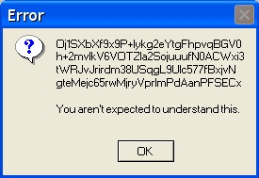
Premise: a Script is Sustainable If …
It clearly explains its operation to Users as it executes
this includes explanations of operational problems and problems with bad data entry, along with suggestions for fixing these problems

Slide 34
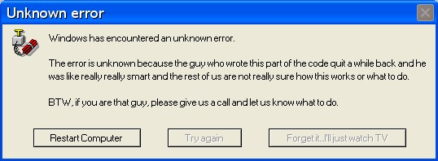
Premise: a Script is Sustainable If …
It clearly documents its operation for maintainers, via
an extended header comment stating the script's name, purpose, parameters, outputs, effects, and special design considerations
variable declarations that identify and document
add-ons to the standard Unix environment that the script depends on
default values for any items that aren't specified or are absent

Slide 35
Premise: a Script is Sustainable If …
It conforms to other precepts of effective software design: e.g.,
Uses meaningful names for script variables
Honors the "0, 1, or many" principle of logic design: i.e.,
Imposes no arbitrary limits on the number of instances of a resource that a script can use
The concern:
If a design supports at most four instances of a thing
Someone, someday, will wreck the logic by asking for five of the thing … or more
Honors the DRY ("don’t repeat yourself") principle of logic design: i.e., localizes repetitive logic in functions or supporting scripts

Slide 36
CSCI 2200: Intro to Unix stylistic recommendations

Slide 37
Stylistic Recommendations: Format
The presentation treats a script as a four-part entity
Header
Prologue
Body
Epilogue
What follows: recommendations for each part

Slide 38
Header
#!/bin/bash
#
# Script name – brief description of purpose
#
# List of input arguments, types, and purposes
# Description of content written to stdout
# Description of content written to stderr
# Description of side effects, especially operations on files
# Any special considerations related to the script's implementation
# =================================================================
Posix convention: identify a script's language in a script's first line
line 1, column 1: # – bash comment character
line 1, column 2: ! – signals a directive
line 1, column 3ff: path to interpreter
The rest is standard best practice

Slide 39
Prologue Part 1
set -o nounset
# For every constant the script uses, including every external file
# -. define a variable with that file's name as its value
# -. include a comment that describes the constant's significance
# If the script uses temporary files, list all in an array: e.g.,
# if the constants section declares three temp files like
# doesthis=file1.tmp
# doesthat=file2.tmp
# doesother=file3.tmp
#
# define a list that captures the name of all files like
declare –a tempfiles=( "$doesthis" "$doesthat" "$doesother" )
set -o nounset treats references to undefined variables as errors.
Naming external dependencies and constants in a script's prologue makes them easy to locate and change

Slide 40
Prologue Part 1
set -o nounset
# For every constant the script uses, including every external file
# -. define a variable with that file's name as its value
# -. include a comment that describes the constant's significance
# If the script uses temporary files, list all in an array: e.g.,
# if the constants section declares three temp files like
# doesthis=file1.tmp
# doesthat=file2.tmp
# doesother=file3.tmp
#
# define a list that captures the name of all files like
declare –a tempfiles=( "$doesthis" "$doesthat" "$doesother" )
Naming all temp files in one list allows for one loop to delete all
This is an example of a "0, 1, or many" approach to crafting logic
Quoting names allows the list to contain filenames with spaces

Slide 41
Prologue Part 2
# If the script uses a set number of command line parameters
# FIRST, check that the right number of parameters has been specified
# assume minparams and maxparams are set appropriately
if [ $# -lt $minparams ] || [ $# -gt $maxparams ]; then
echo "?? $0: incorrect number of parameters supplied – $#" >/dev/stderr
echo "?? command format: $0" followed by calling convention >/dev/stderr
exit 1
fi
# THEN, audit each parameter for correctness.
params_OK=true
# The audit tests go here – one per checkable parameter
# For each failed audit, print an error message and set params_OK=false
if [ $params_OK != "true" ]; echo "?? $0: parameter error – exiting"; exit 1; fi
Check the number and values of a script's parameters
Help users by postponing the error exit until all parameters are checked and error messages generated
Include $0 in error messages to show the name used to invoke the script

Slide 42
Prologue Part 3
# If the script uses temporary files
# Check that none of the files to be used currently exists,
# to prevent the accidental overwriting of a user's content
#
all_temp_files_missing=true
for (( i=0; i<${#tempfiles[*]}; i++ )); do
if [ -f ${tempfiles[i]} ]; then
echo '?? please delete ' ${tempfiles[i]} ' then re-run ' $0;
all_temp_files_missing=false
fi
done
if [ all_temp_files_missing != "true" ]; then echo '?? exiting'; exit 1; fi
Treat the presence of files that the script intends to use as temporary files as a cause for aborting processing
[ -f ${tempfiles[i]} ] checks for the presence of the i^{th} tempfile

Slide 43
Body
# ** invoke rm_f to remove any temporaries on the event of exit **
#
function rm_f { for ((i=$#; i>0; i--)); do rm -f $1; shift; done }
trap 'if [ ${#tempfiles[*]} –gt 0 ]; then rm_f "${tempfiles[@]}"; fi; \ echo interrupt >/dev/stderr; exit 2' SIGINT SIGQUIT
trap 'if [ ${#tempfiles[*]} –gt 0 ]; then rm_f "${tempfiles[@]}"; fi; \ echo script err >/dev/stderr; exit 3' ERR
# Insert the script's body here.
# After each command
# -. test $? to see if the command succeeded
# -. on failure, print an error message, # invoke rm_f "${tempfiles[@]}" if temporaries are in use, and exit
If temporary files are in use, use traps to remove all temporaries on signals
For clarity, use a separate trap for script errors
At a minimum, trap SIGINT, SIGQUIT, and ERR
Delay setting traps until after establishing the absence of user file-script temp file naming conflicts

Slide 44
Body
# Prevent the accidental overwriting of a user's content
#
function rm_f { for ((i=$#; i>0; i--)); do rm -f $1; shift; done }
trap 'if [ ${#tempfiles[*]} –gt 0 ]; then rm_f "${tempfiles[@]}"; fi; \ echo interrupt >/dev/stderr; exit 2' SIGINT SIGQUIT
trap 'if [ ${#tempfiles[*]} –gt 0 ]; then rm_f "${tempfiles[@]}"; fi; \ echo script err >/dev/stderr; exit 3' ERR
# Insert the script's body here.
# After each command
# -. test $? to see if the command succeeded
# -. on failure, print an error message, # invoke rm_f "${tempfiles[@]}" if temporaries are in use, and exit
Use a function like rm_f to consolidate cleanup logic (DRY)
${tempfiles[@]} is used to pass the list of files as a list of distinct strings
rm -f $1; shift; removes each parameter in turn
Declare this function before any of the codes that call it could run
To avoid errors, don't reference tempfiles[@] when tempfiles is empty

Slide 45
Aliases in Scripts
Aliasing, by default, is disabled in non-interactive bash sessions
Includes bash scripts
Advantages
Assures that scripts are self-contained
Avoids potential security issues due to malicious aliases
If aliases are desired
Add shopt -s expand_aliases to script
If default aliases are required, source the relevant alias-defining files, like .bashrc
Source: https://unix.stackexchange.com/questions/1496/why-doesnt-my-bash-script-recognize-aliases

Slide 46
Recommendations: Epilogue
Make sure to return the appropriate final status and clean up all temporary files, if any
To delete these temp files, use the cleanup function used by the trap statements—here, rm_f—for maintainability

Slide 47
JSON
JavaScript Object Notation

Slide 48
JSON
Common data transport language
Used (a lot) in JavaScript, but also other applications
Provides standardized means of moving data from one machine to another
Consists of arrays of JSON objects

Slide 49
JSON Object
{
"key1" : "value1", "key2" : "value2", "key3" : "value3", "keyN" : "valueN“ }

Slide 50
JSON
Arrays are comma-delimited lists enclosed in square brackets ([])
So, a JSON file starts with ‘[‘, includes 1..many JSON objects, and ends with ‘]’

Slide 51
JSON File
[ {
"key1" : "value1", "key2" : "value2", "key3" : "value3", "keyN" : "valueN“ }, {
"key1" : "value1", "key2" : "value2", "key3" : "value3", "keyN" : "valueN“ },
{
"key1" : "value1", "key2" : "value2", "key3" : "value3", "keyN" : "valueN“ } ]
VALUES’ “VALUES” DIFFERENT
KEYS’ VALUES SAME

Slide 52
JSON
We’ll use this in our in-class activity next time ☺

